Slide 1
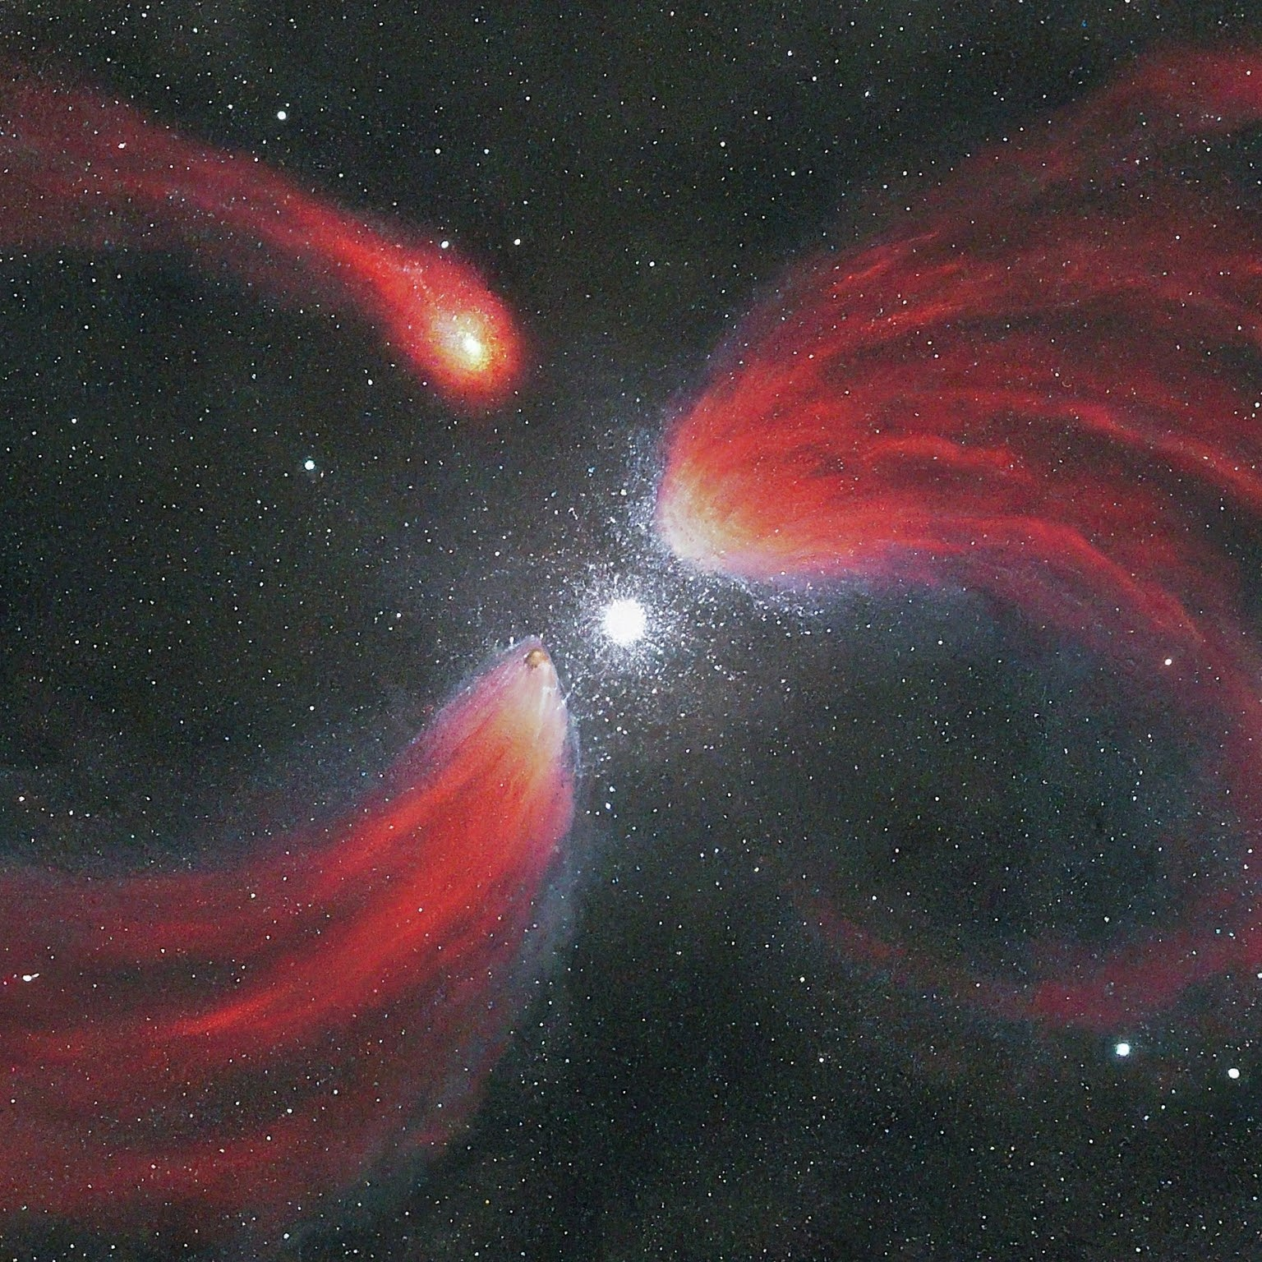
CONFIRMATION OF MAGNETIC CATACLYSMIC VARIABLE CANDIDATES THROUGH SPECTROSCOPY
Presented by:
Sampda Raj
Ashish Joshi
Shaily Dewangan
Shivam Anand Sony
Mahiguhappriyaprakash
Guided by:
Srinivas M Rao

Slide 2
CONTENTS
MAGNETIC CATACLYSMIC VARIABLES
SPECTROSCOPY IN ASTRONOMY
SPECTROSCOPIC ANALYSIS OF MAGNETIC CVs
ANALYSIS USING IRAF
CLEANING THE IMAGE
EXTRACTING THE SPECTRA
WAVELENGTH CALIBRATION
FLUX CALIBRATION
RESULT AND CONCLUSION

Slide 3
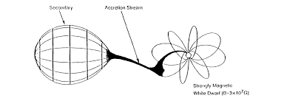
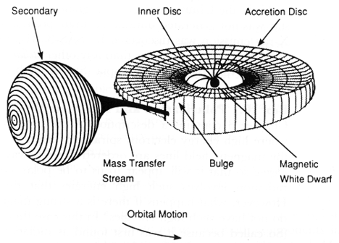
Magnetic Cataclysmic Variables
A specific type of binary star system characterized by a primary white dwarf and a secondary red dwarf.
The presence of this magnetic field disrupts the formation of traditional accretion disk.
Magnetic CVs
Polars
Intermediate Polars
Magnetic field strong enough to control the accretion flow, preventing the formation of an accretion disc and generating the signatures of magnetic accretion.
The weaker magnetic field (as compared to the polars) allows some of the accreted gas to form a truncated accretion disk around the white dwarf's equator.
Fig : Polar Magnetic CVs
Giovannelli, Franco. (2008). Cataclysmic Variables: A Review. Bath Bath et al. 8.
Fig : Polar Magnetic CVs
Giovannelli, Franco. (2008). Cataclysmic Variables: A Review. Bath Bath et al. 8.

Slide 4
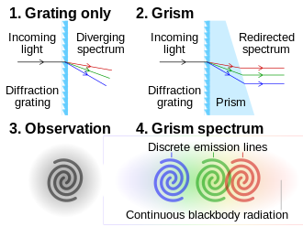
Spectroscopy
A scientific method to study the physical properties of luminous objects.
Physical properties include: chemical composition, temperature, density, and magnetic field
Spectra of an astronomical object is obtained by having a slit in front of the CCD, making sure the source is at the center of the slit.
As a result, we get an image with a horizontal line, called the dispersion axis, which consists of the spectral data of the source, and a vertical axis called the spatial axis.
Fig : Grism Source:Wikipedia
Slit
Spatial axis
Dispersion axis
Source
Fig : Spectra obtained on a CCD

Slide 5
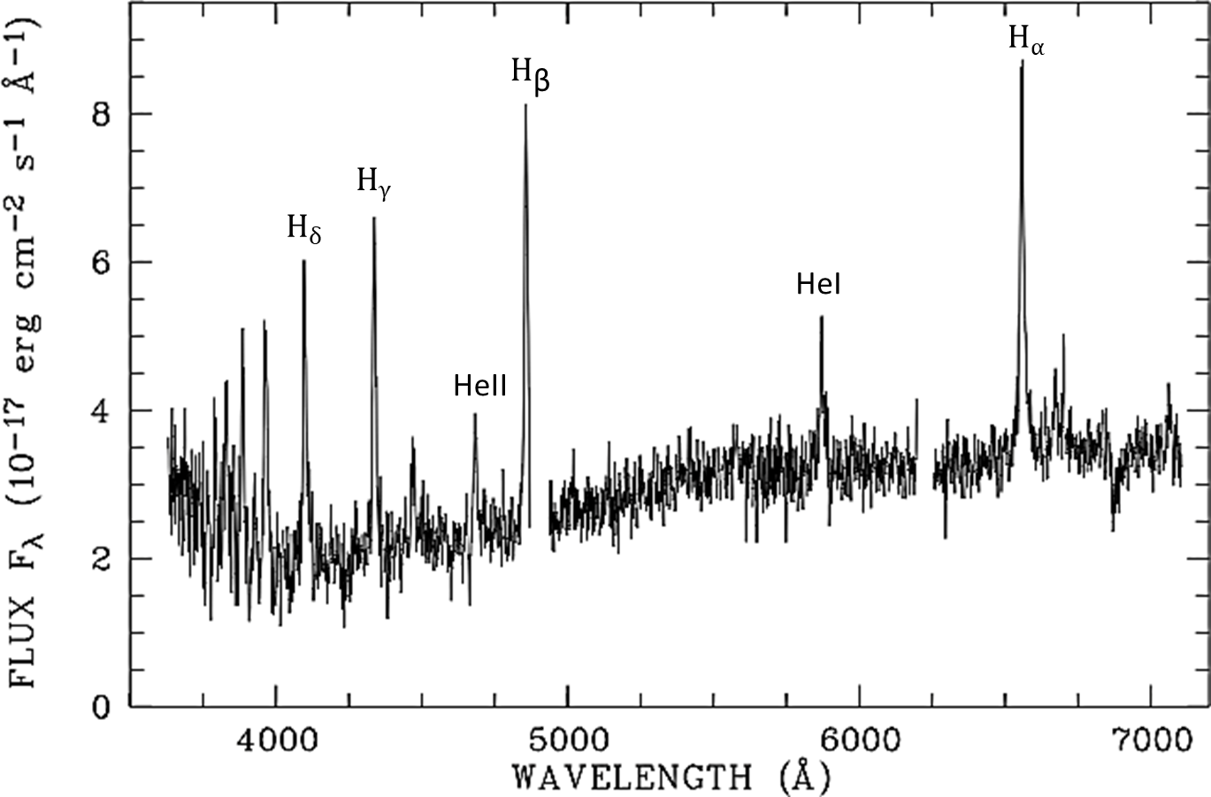
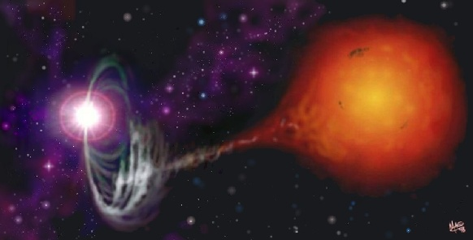
SPECTROSCOPIC ANALYSIS OF MAGNETIC CVs
The presence or absence of certain lines in the spectra can help us determine if the source is a MCV or not.
The prominent features in the spectra of a MCV are emission Balmer lines and He II lines.
If the spectra of a binary system consists of these lines, then it is a MCV.
Picture credit: M. A. Garlick © 1998

Slide 6
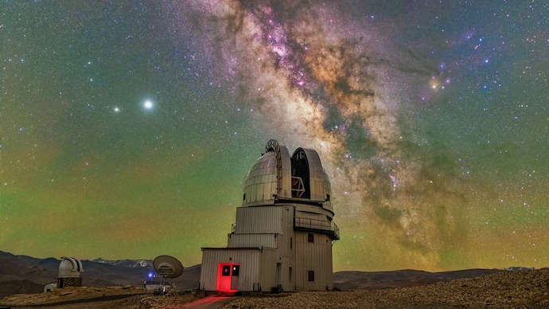
Observation
The object we have reduced is Swift J0746.2-1611. The source was observed from the 2-m Himalayan Chandra Telescope (HCT) at the Indian Astronomical Observatory(IAO), Hanle.

Slide 7
Observation
Data
The object we have reduced is Swift J0746.2-1611. The source was observed from the 2-m Himalayan Chandra Telescope (HCT) at the Indian Astronomical Observatory(IAO), Hanle.
bias_01.fits
bias_02.fits
bias_03.fits
halogen_01.fits
halogen_02.fits
halogen_03.fits
Source
Standard
Source_arc_lamp
Standard_arc_lamp

Slide 8
Data
Cleaning The Image
bias_01.fits
bias_02.fits
bias_03.fits
halogen_01.fits
APERTURE EXTRACTION
halogen_02.fits
halogen_03.fits
Source
Standard
WAVELENGTH CALIBRATION
Source_arc_lamp
Standard_arc_lamp
FLUX CALIBRATION

Slide 9

Cleaning The Image
The image obtained from the CCD is to be cleaned due to the distortions produced by the defects or some other features of the instrument.
Bias is basically the noise produced due to the excess number of counts even when the exposure is zero.
For the bias correction ,we will make the master bias by using zerocombine task of IRAF.
Then the master bias will be subtracted from all other frames to form bias subtracted frames.
bias_01.fits
bias_02.fits
mbias.fits
bias_03.fits

Slide 10
Data
mbias.fits
halogen_01.fits
halogen_02.fits
halogen_03.fits
Source
Standard
Source_arc_lamp
Standard_arc_lamp

Slide 11
Data
halogen_01.fits
halogen_02.fits
halogen_03.fits
mbias.fits
mbias.fits
mbias.fits
Source
Standard
mbias.fits
mbias.fits
Source_arc_lamp
Standard_arc_lamp
mbias.fits
mbias.fits

Slide 12
Data
halogen_01_b.fits
halogen_02_b.fits
halogen_03_b.fits
Source_b
Standard_b
Source_arc_lamp_b
Standard_arc_lamp_b

Slide 13
Flat frame is used to maintain the uniformity of the image.
The non-uniformity in the image is due to the slightly different efficiencies of each pixel.
The flat correction can be done by using any uniform light source.
We will do the flatcombine task to make the master flat.
halogen_01_b.fits
halogen_02_b.fits
mflat.fits
nmflat.fits
halogen_03_b.fits

Slide 14
Data
nmflat.fits
Source_b
Standard_b
Source_arc_lamp_b
Standard_arc_lamp_b

Slide 15
Data
Source_b
Standard_b
nmflat.fits
nmflat.fits
Standard_arc_lamp_b
Source_arc_lamp_b
nmflat.fits
nmflat.fits

Slide 16
Data
Source_bf
Standard_bf
Standard_arc_lamp_bf
Source_arc_lamp_bf

Slide 17
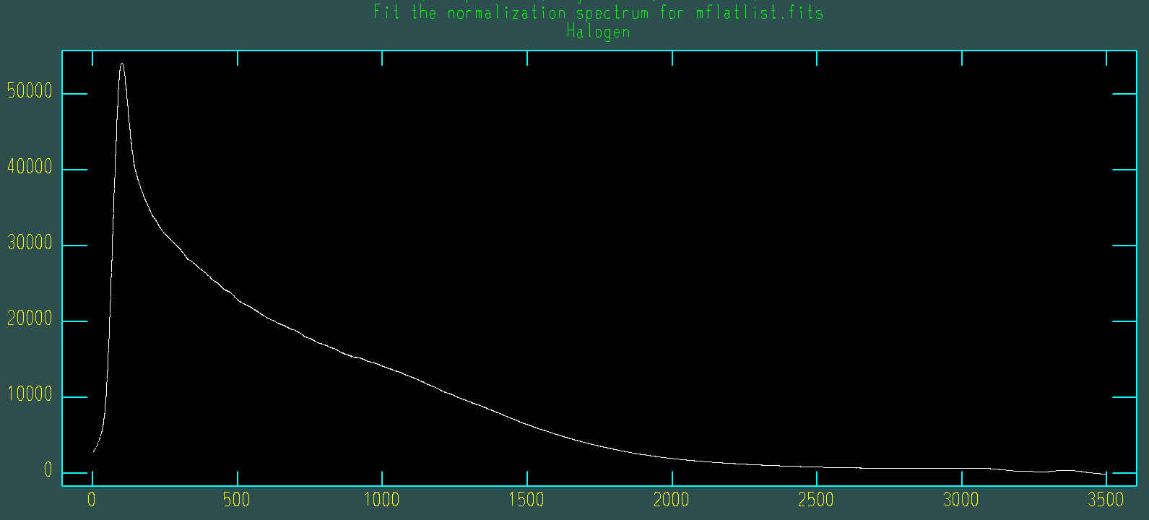
The normalized spectrum for master flat.

Slide 18
Cosmic Ray Correction
Cosmic rays are highly energetic particles originated from outer space. They have very high counts when they fall on the CCD. So these have to be removed before reducing the spectra. This is done by using crmedian task of IRAF.
Cosmic Rays
Before Cosmic Ray Correction
After Cosmic Ray Correction
Notes:
Needs to corrected

Slide 19
Cleaned Data
Source
Standard
Standard_arc_lamp
Source_arc_lamp

Slide 20
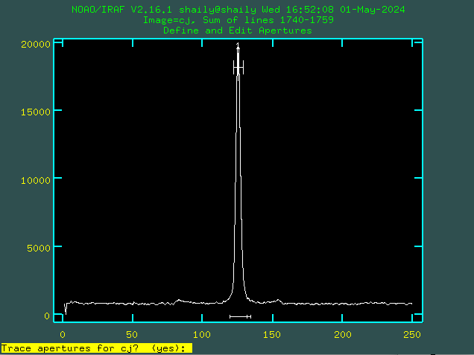
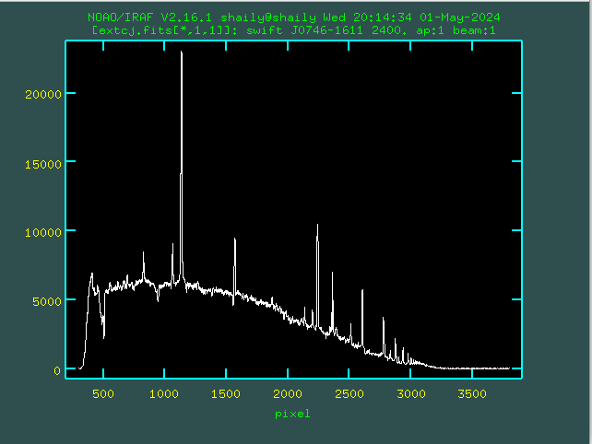
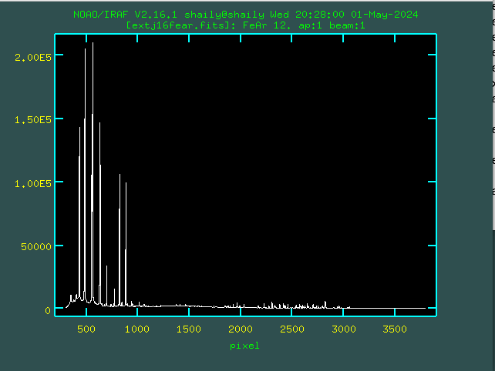
REDUCTION OF SPECTROSCOPIC DATA
The spectroscopic data reduction consists steps such as “Aperture Extraction, Wavelength Calibration and Flux Calibration”. The spectroscopic data reduction is done using IRAF. The steps involved in the entire reduction are explained below :-
Aperture Extraction : The one-dimensional spectrum of science frame and Arc lamp is extracted interactively with “apall” task of IRAF. After setting the aperture and background it traces spectrum. We get extracted spectrum that is plot between Counts and Pixel number.
Fig:Pixel vs Counts
Fig: Extracted spectra of J07460-1611
Fig: Extracted spectra of J074-1611_FeAr

Slide 21
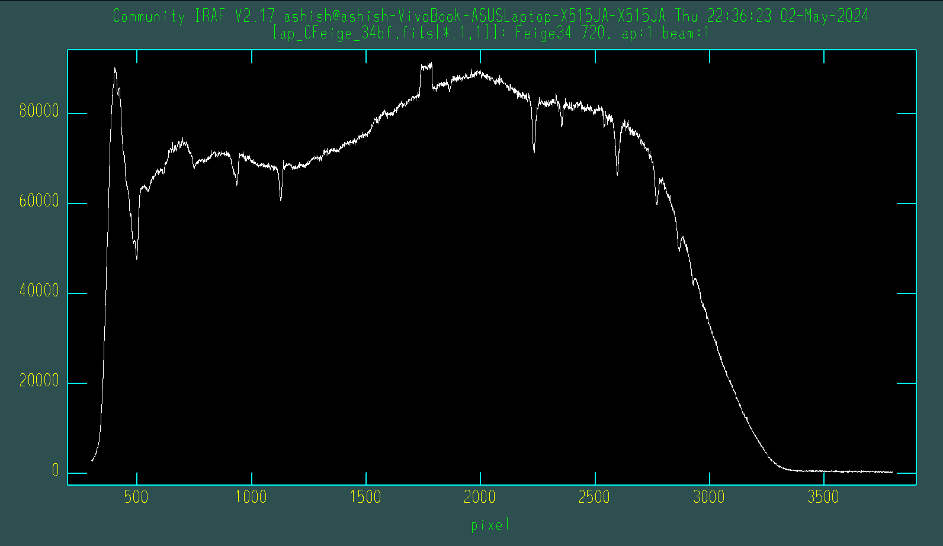
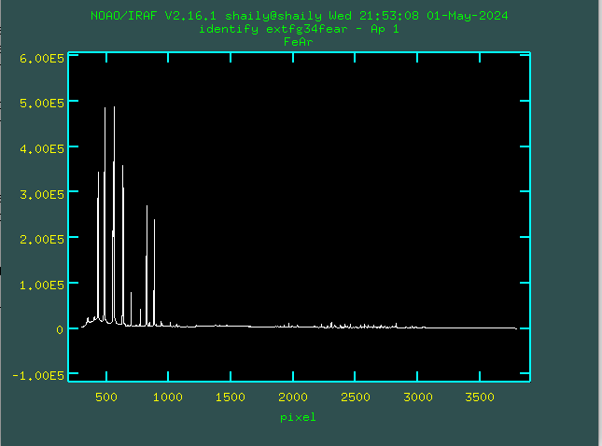
Spectra after Aperture Extraction
Source
Standard
Source_arc_lamp
Standard_arc_lamp

Slide 22
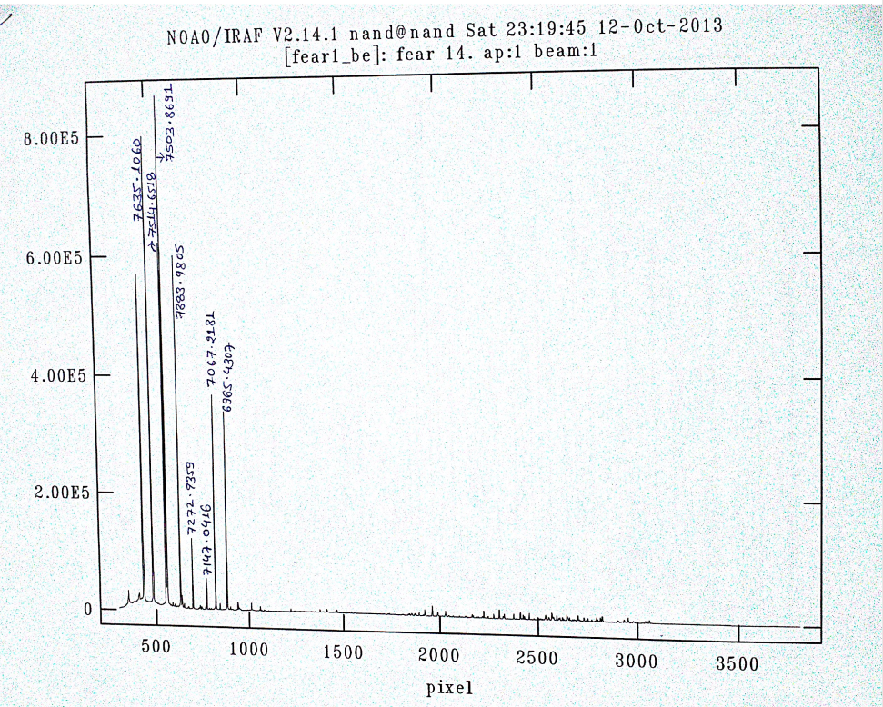
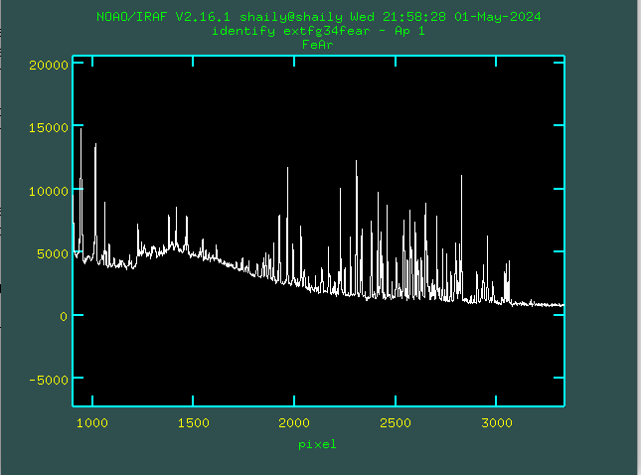
WAVELENGTH CALIBRATION
The next step is to convert the extracted spectrum from the pixel scale into the wavelength scale. The Arc lamp of standard and source star are used for this purpose. The pixel number is converted into wavelength using the spectra of Arc lamp (FeAr) of standard and source star. Wavelength Calibration using IRAF is done through identify, hedit and dispcor tasks.
Fig: Line identification of arc lamp of Feige 34
Fig: Standard identified line of arc lamp of Feige 34

Slide 23
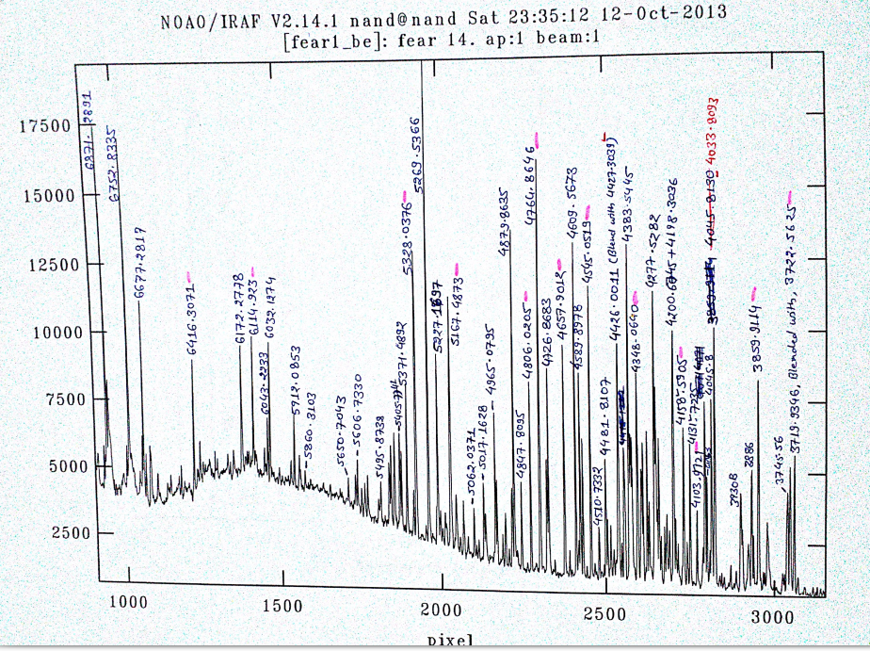
The line identification of arc lamp of source star (J0746M1611_FeAr) is done using the same “identify” syntax. After that database of both the star is created which is transferred in standard and source star through hedit. And then using dispcor the calibrated wavelength is obtained.

Slide 24
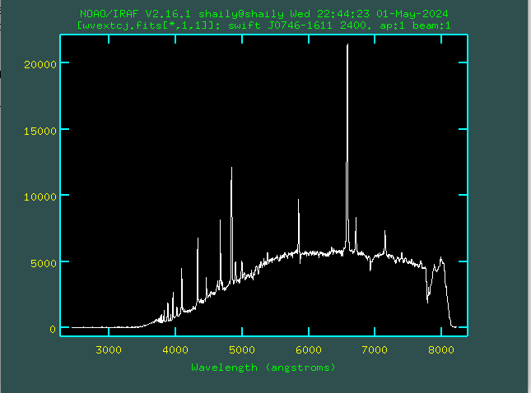
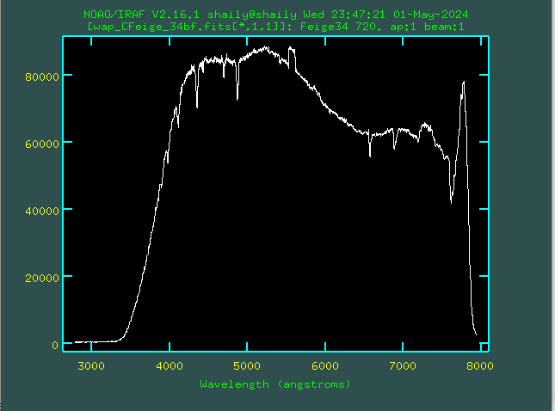
WAVELENGTH CALIBRATION
Source
Standard

Slide 25
FLUX CALIBRATION
Now we have the wavelength calibrated spectrum but we want flux instead of counts in the y-axis. First, we do it for the standard star.
It will be done with the help of the standard database provided by IRAF itself and this is done by using standard task.

Slide 26
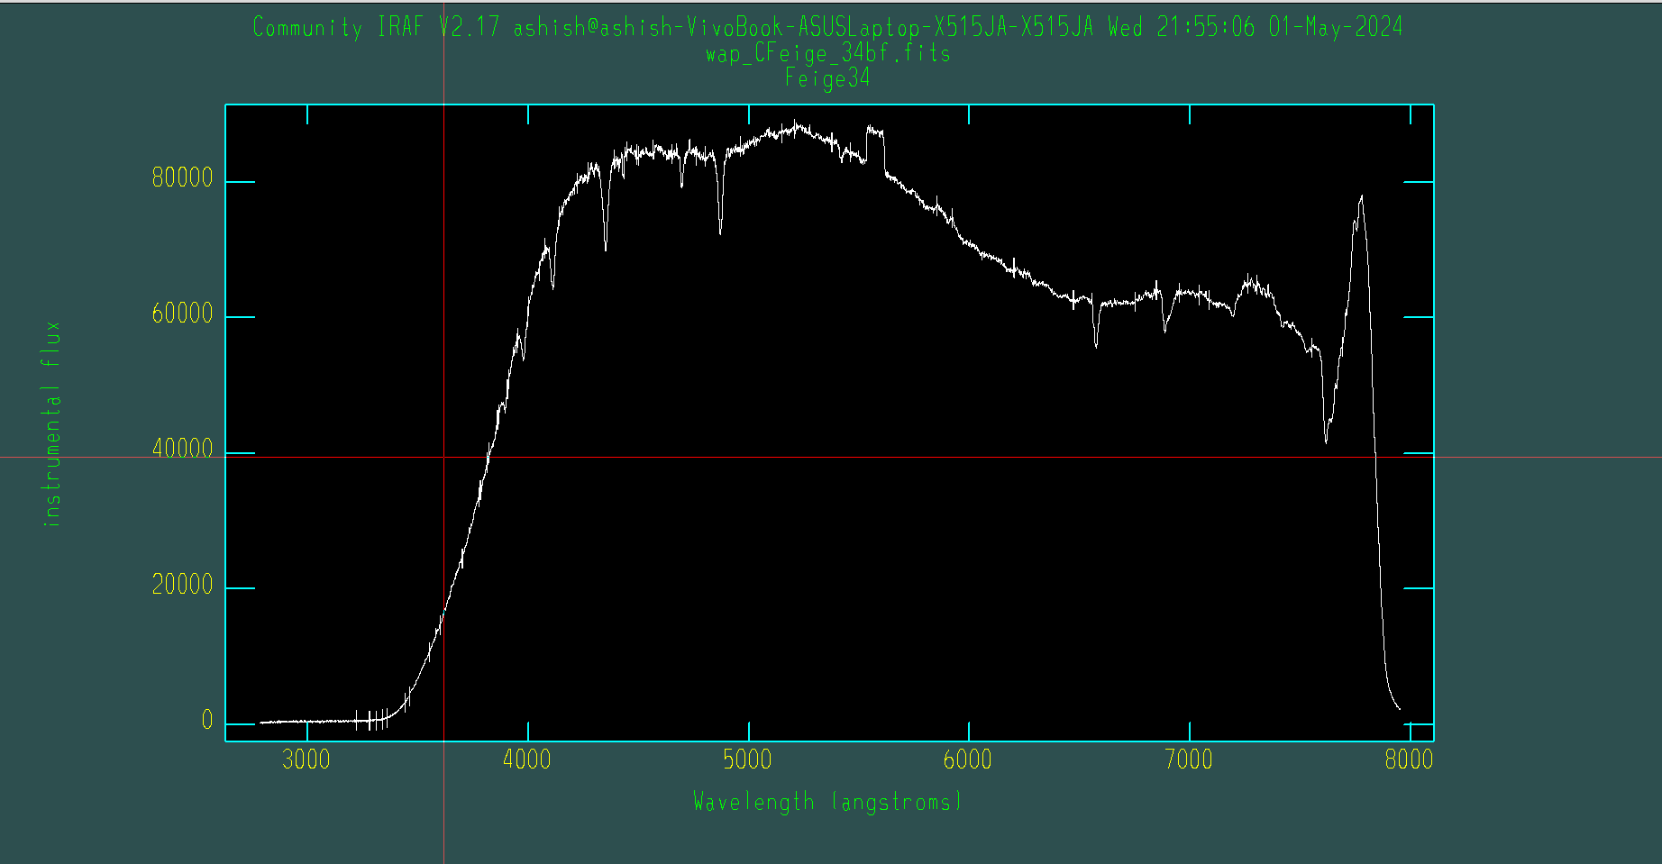
FLUX CALIBRATION
Now we have the wavelength calibrated spectrum but we want flux instead of counts in the y-axis. First, we do it for the standard star.
It will be done with the help of the standard database provided by IRAF itself and this is done by using standard task.

Slide 27
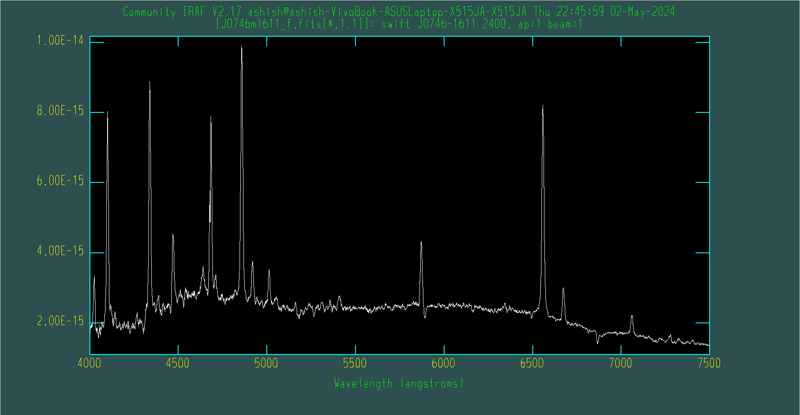
FLUX CALIBRATION
Now this information is used to do the Flux Calibration in the source using the tasks sensfunc and calibrate.

Slide 28
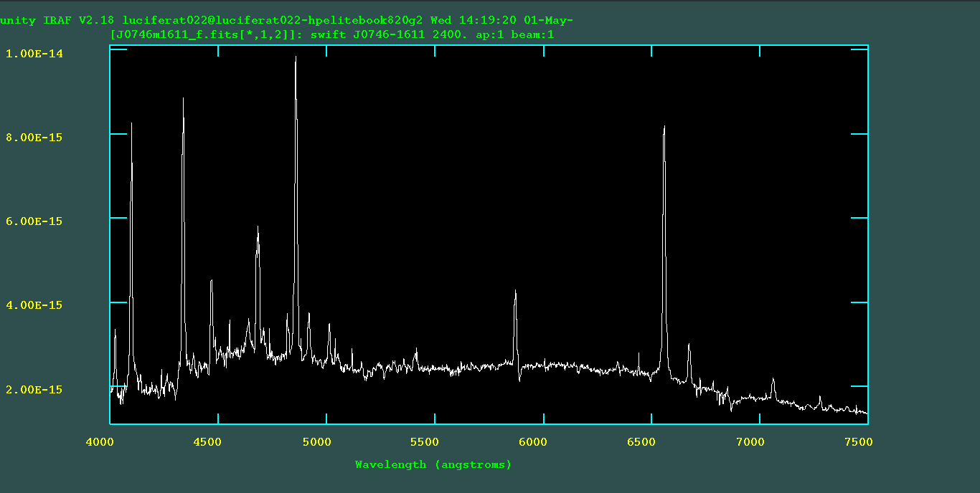
RESULT AND CONCLUSION
H_{β}
H_{γ}
H_{α}

Slide 29
THANK YOU!

